Slide 1
MongoDB
Modern Document-model database.
Designed to back the modern-day business applications:
Developer and Operations oriented
Easy to scale horizontally
What two RDBMS functions are hard to do efficiently in a distributed system?

Slide 2
Relational Data Model
EmpID | Name | Dept | Title | Manage | Payband
9950 | Dunham, Justin | 500 | 1500 | 6531 | C
EmpBenPlanID | EmpFK | PlanFK
1 | 9950 | 100
2 | 9950 | 200
PlanID | BenFK | Plan
100 | 1 | PPO Plus
200 | 2 | Standard
BenID | Benefit
1 | Health
2 | Dental
TitleID | Title
1500 | Product Manager
DeptID | Department
500 | Marketing

Slide 3
Relational - Denormalization
EmpID | Name | Dept | Title | Manage | Payband
9950 | Dunham, Justin | Marketing | Product Manager | 6531 | C
EmpBenPlanID | EmpFK | BenType | Plan
1 | 9950 | Health | PPO Plus
2 | 9950 | Dental | Standard

Slide 4
Document - Arrays
EmpID | Name | Dept | Title | Manage | Payband | BenType | Plan
9950 | Dunham, Justin | Marketing | Product Manager | 6531 | C | Health | PPO Plus
 |  |  |  |  |  | Dental | Standard

Slide 5
Document Model Representation - JSON
{
"_id" : 9950,
"pay_band": "C",
"employee_name": "Dunham, Justin",
"department" : "Marketing",
"title" : "Product Manager, Web",
"report_up": "Neray, Graham",
"benefits" : [
{ "type" : "Health",
"plan" : "PPO Plus" },
{ "type" : "Dental",
"plan" : "Standard" }
]
}

Slide 6
Document Storage - BSON
{
"_id" : 9950,
"pay_band": "C",
"employee_name": "Dunham, Justin",
"department" : "Marketing",
"title" : "Product Manager, Web",
"report_up": "Neray, Graham",
"benefits" : [
{ "type" : "Health",
"plan" : "PPO Plus" },
{ "type" : "Dental",
"plan" : "Standard" }
]
}
\x315\x00\x00\x00
\x01
_id\x00
\x01\x00\x00\x00
0x26de\x00
\x02
pay_band\x00
\x02\x00\x00\x00
C\x00
\x02
employee_name\x00
\x02\x00\x00\x00
Dunham, Justin\x00
.
.
\x00

Slide 7
Terminology
RDBMS
Database
Table
Row
Column
Index
Database
Collection
Document
Field
Index
MongoDB
Namespace

Slide 8
MongoDB - Agility
EmpID | Name | Dept | Title | Manage | Payband | BenType | Plan
9950 | Dunham, Justin | Marketing | Product Manager | 6531 | C | Health | PPO Plus
 |  |  |  |  |  | Dental | Standard
EmpID | Name | Title | Payband | Bonus
9952 | Joe White | CEO | E | 20,000
EmpID | Name | Dept | Title | Manager | Payband | Shares
9531 | Nearey, Graham | Marketing | Director | 9952 | D | 5000

Slide 9
MongoDB - Usability
Command-line shell for interacting directly with database
Compass as a GUI to access the database
> db.collection.insertOne({
product:"MongoDB",
type:"Document Database"
})
> db.collection.findOne()
{
"_id": ObjectId("5106c1c2fc629bfe52792e86"),
"product": "MongoDB",
"type": "Document Database"
}

Slide 10


Availability and Scalability
Replica Set
High Availability via Replica Sets
Multiple copies of all data
Different hosts / locations
Continuous replication
Scale via Shards
Partition data over multiple Replica Sets
Provides unlimited hardware scaling
Compression of data
High availability - Replication
Shard 1
Shard 2
… Shard N
Horizontal scalability - Sharding

Slide 11
Enterprise Tooling
Enterprise Management Tools:
Atlas - MongoDB Database as A Service
Ops Manager - Monitor/Alert/Manage/Backup your own servers.
Cloud Manager - Ops Manager hosted in the cloud.
Kubernetes Operator to deploy in containers.
Terraform Provider from Hashicorp.

Slide 12
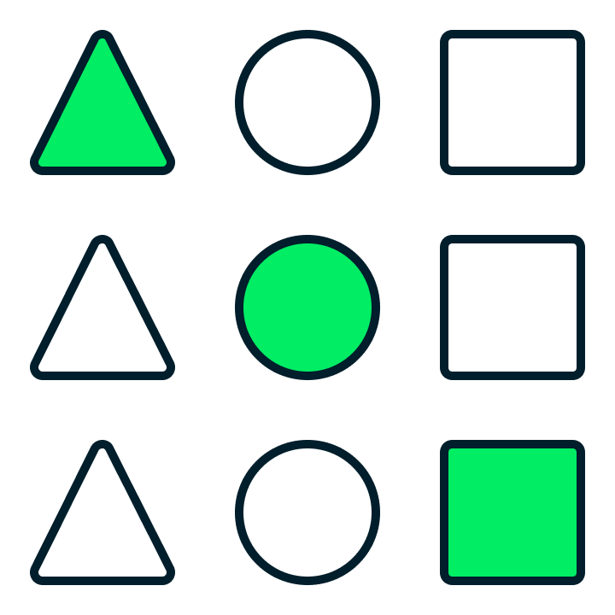

When MongoDB should be used
When you need high-speed access to complex objects
Atomic partial updates
Fast retrieval
Secondary indexes
Aggregation capabilities
When you want to store larger data structures together
Large Arrays
Text Fields
Binary Data

Slide 13


When MongoDB should be used (Cont.)
When you value rapid development
Interaction by Objects
Rich functionality
Where you need to store structures of varying shapes.
Application-defined schemas
Heterogeneous schemas

Slide 14


When MongoDB should be used (Cont.)
When we have large data volumes.
Data volumes growing
Growth potentially unlimited.
No big up-front payment.
When we want distributed data.
Worldwide low latency.
Legal obligations for locations.
Real-time distribution.

Slide 15


Things to be conscious of
Easy to build with no training.
Easy to get wrong.
Performance can suffer
Issues can arise too late!
DBAs need to be trained and certified.
Developers do traditional DBA tasks.
But DBAs have tasks too.
Forget them at your peril.
Or use DBaaS like Atlas.

Slide 16

With MongoDB
Data is stored in an efficient binary form on the disk.
You can index and query any field or set of fields.
You can perform atomic updates to one or more records.
You can update parts of records without retrieving them first.
You can compute aggregates and summaries on the server.
Schemas matter and can be rigidly enforced by the server.
All values have a defined data type (String, Integer, Date, etc.).
You can join data together for querying and retrieval.
You can query with SQL using the BI connector add-on.

Slide 17

What is different in MongoDB
You can Query with SQL but normally don't
Interaction is from code using Object-based APIs
Rather than constructing SQL Strings
SQL is used only to enable third-party BI tools.
Documents/Objects are first-order data types
Data modeling/Schema design is done differently
Dynamic schemas can be used if desired
The primary key field is always called _id

